Slide 1

Virtual Drum Kit Project
Welcome to the Virtual Drum Kit Project presentation , which is going to Present by our group members .

Slide 2
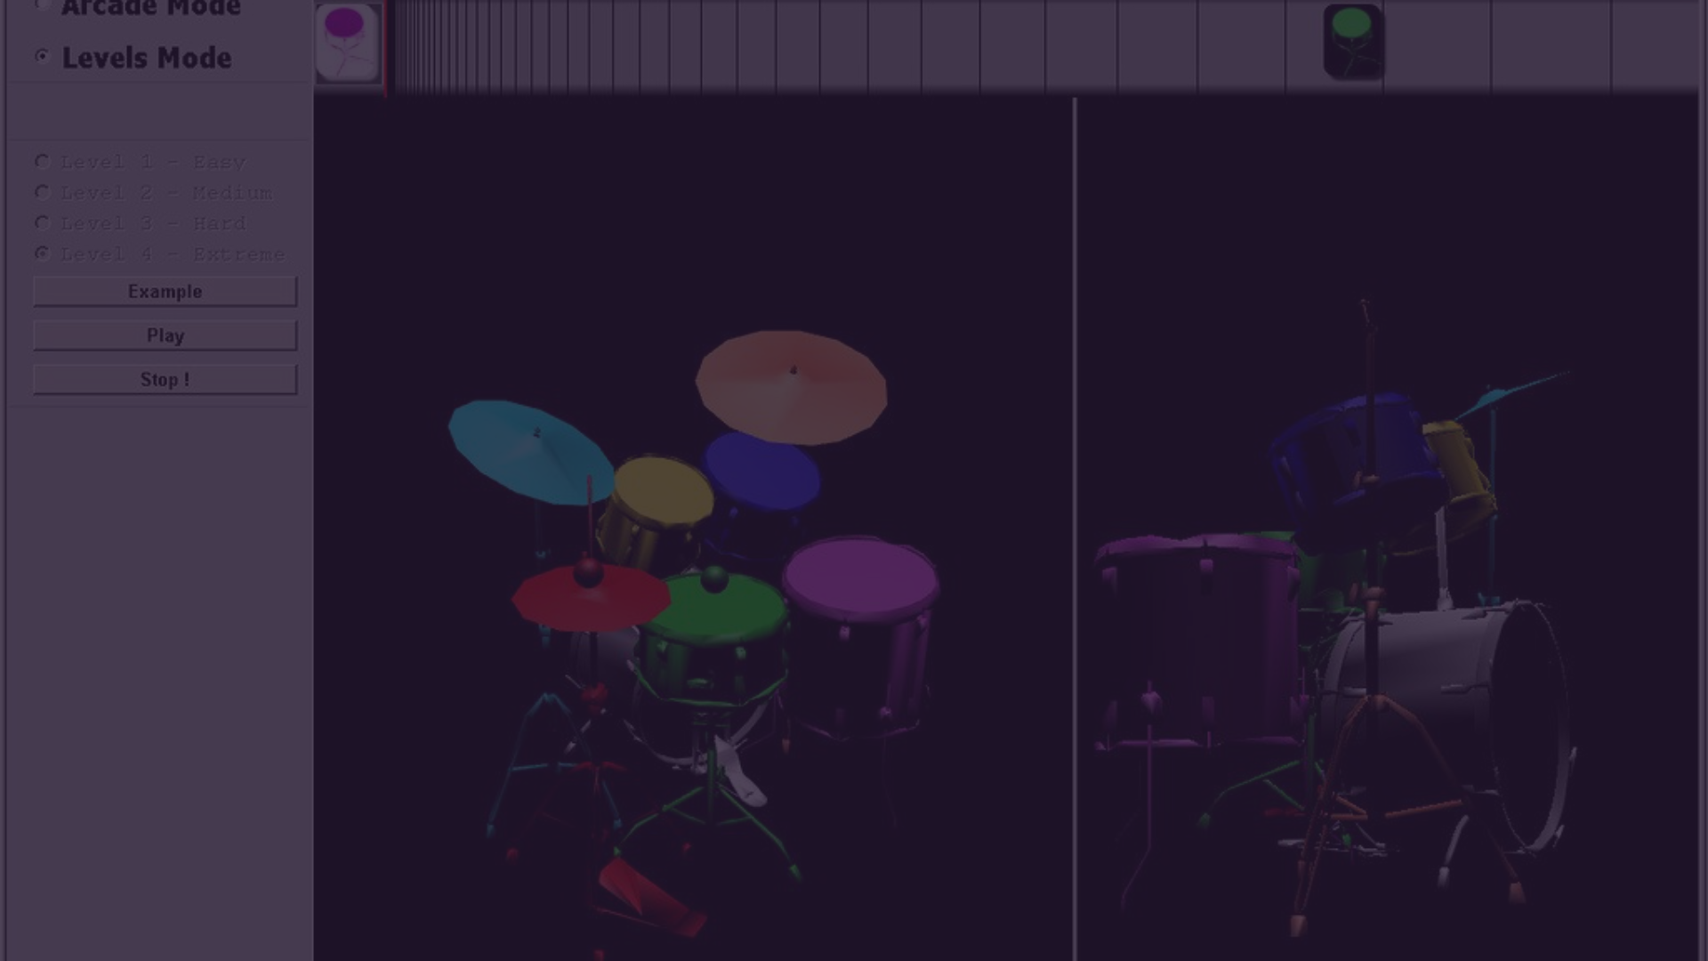
Project Overview
1
What is a virtual drum kit?
2
Purpose of the project
A virtual drum kit is a digital simulation of a traditional drum kit, allowing users to play and create music using a computer or electronic device.
The project aims to provide an interactive platform for entertainment, learning, and musical experimentation.

Slide 3
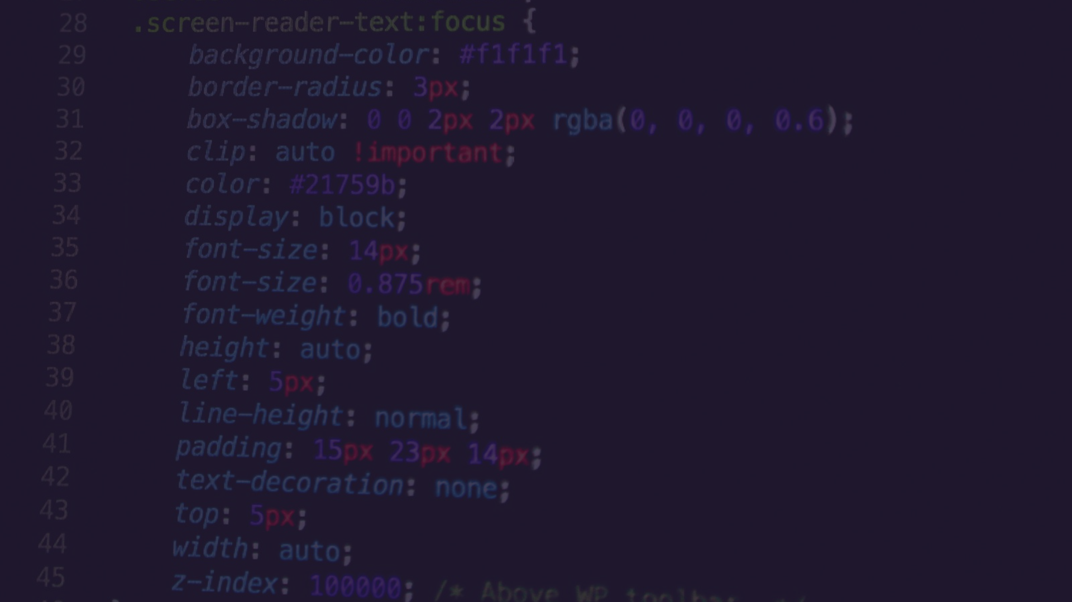
Technologies Used
HTML
CSS
JavaScript
Utilized for structuring the content and elements of the virtual drum kit interface.
Responsible for styling and enhancing the visual presentation of the virtual drum kit.
Enabled interactivity and functionality, making the virtual drum kit responsive to user inputs.

Slide 4
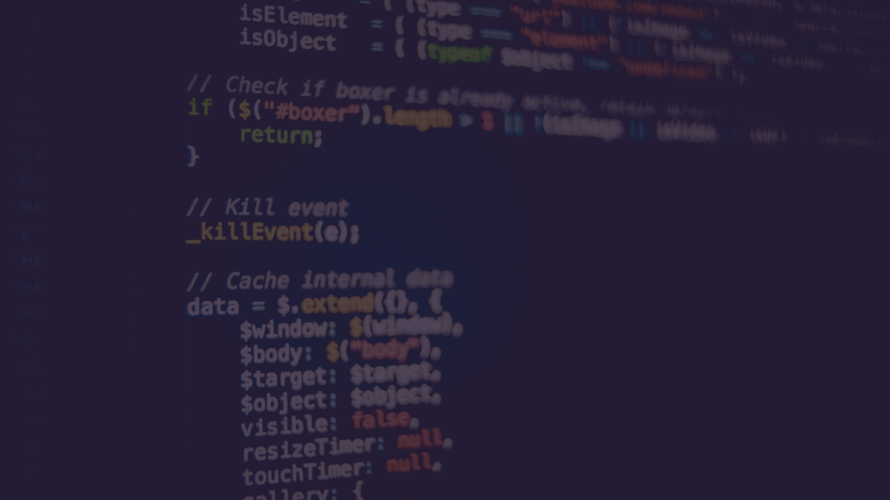
HTML Structure
Overview of HTML Structure
Key Elements
Introduces the hierarchical layout of elements comprising the virtual drum kit, including the arrangement of buttons and interactive components.
Highlights essential HTML elements such as buttons, containers, and attributes utilized in the project's user interface.

Slide 5
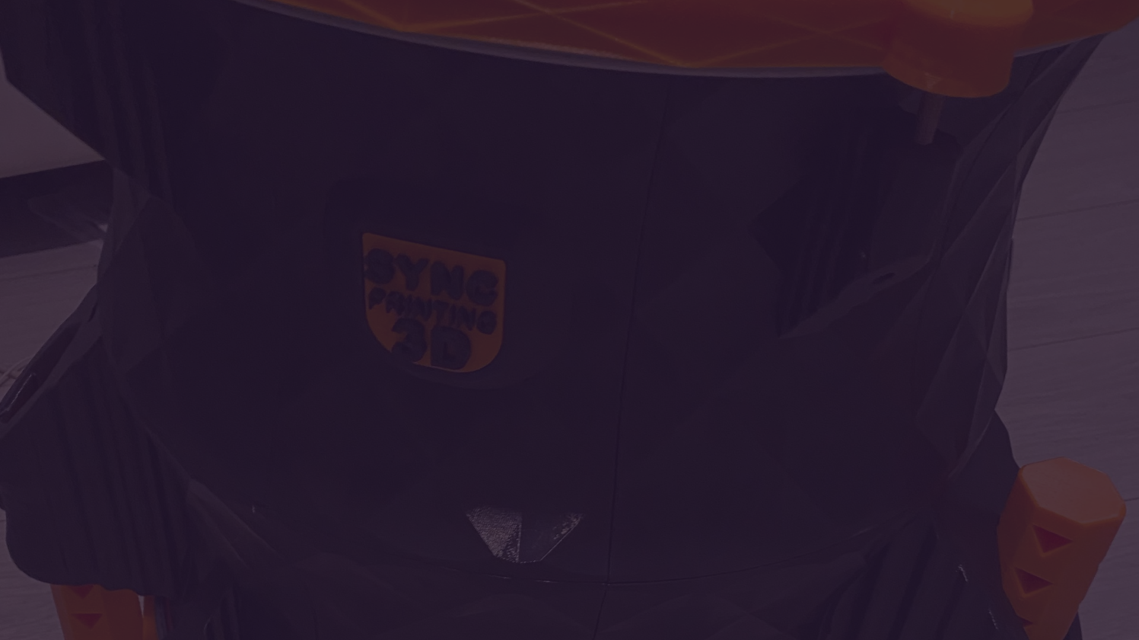
CSS Styling
1
Overview of CSS Styling
Provides insights into the design decisions, color schemes, and visual enhancements applied to the virtual drum kit interface using CSS.
2
Explanation of Styling Choices
Details the rationale behind specific styling choices, aiming to create an engaging and aesthetic virtual drum kit experience.

Slide 6
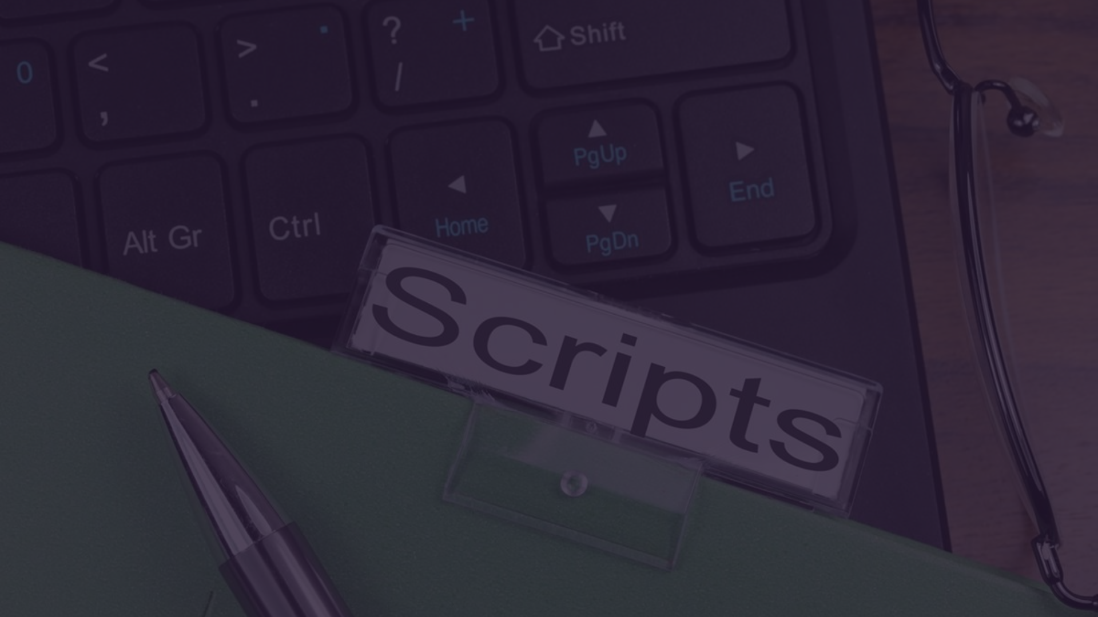


JavaScript Setup
Explanation of JavaScript Code
Event Listeners Setup
Explores the implementation of JavaScript code responsible for enabling user interactions and audio playback functionality within the virtual drum kit.
Demonstrates the method of configuring event listeners to detect button clicks and keyboard inputs, providing a seamless musical experience.

Slide 7

Sound Functionality
Explanation of the Audio function
The mechanism of the Audio function that triggers the playback of corresponding drum sounds upon user actions.

Slide 8

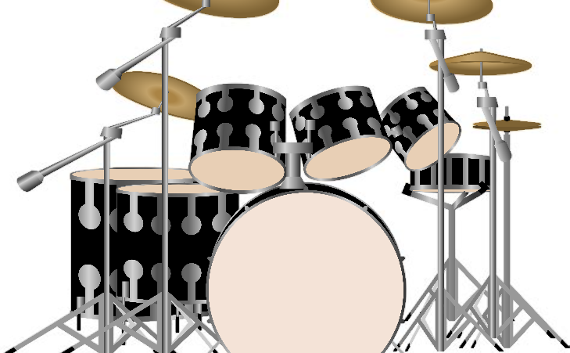
Animation
Button Animation Function
Explains the functionality and implementation of the button Animation function, which adds visual effects when buttons are interacted with.

Slide 9
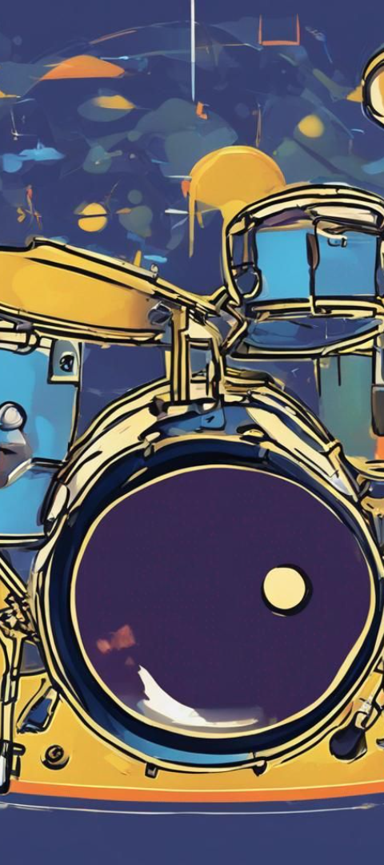
Drum Sounds
1
Kick Drum
2
Snare Drum
Showcases the specific audio file and its role as the kick drum sound in the virtual drum kit.
Highlights the distinct audio file linked to the snare drum sound in the virtual drum kit.
3
Cymbals
Presents the unique audio files utilized for creating cymbal sounds in the virtual drum kit platform.

Slide 10

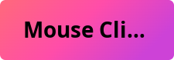

User Interaction
Illustrates how users can interact with the virtual drum kit through both mouse clicks and key presses, offering a versatile and user-friendly experience.

Slide 11

Thank You for Joining Us!
We appreciate your time and attention throughout this presentation. It was a pleasure to have you with us. If you have any further questions or would like to learn more, please don't hesitate to reach out. Thank you again!

